Slide 1
Review of Arduino Basics

Slide 2
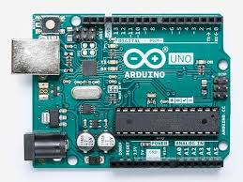
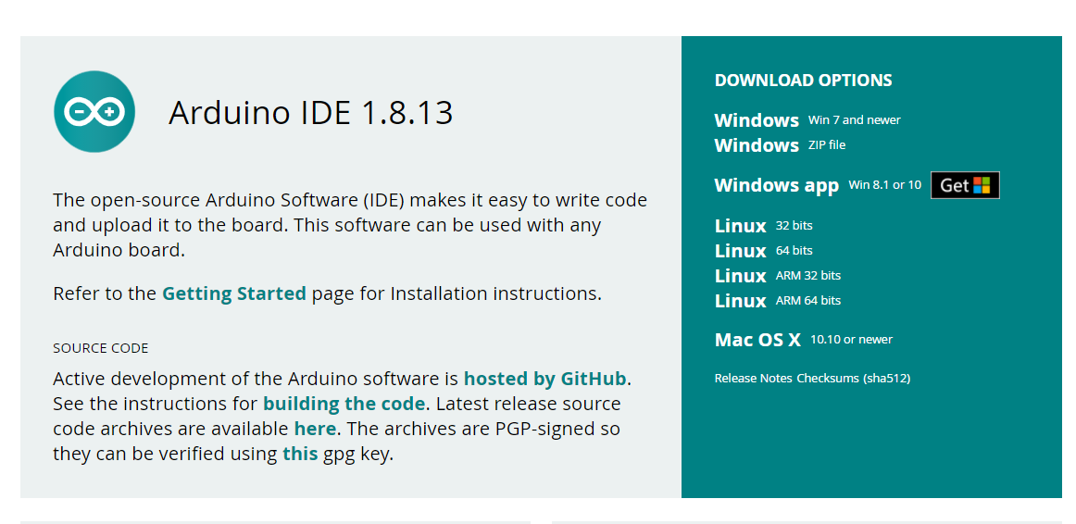
Actually consists of
Hardware
Software

Slide 3
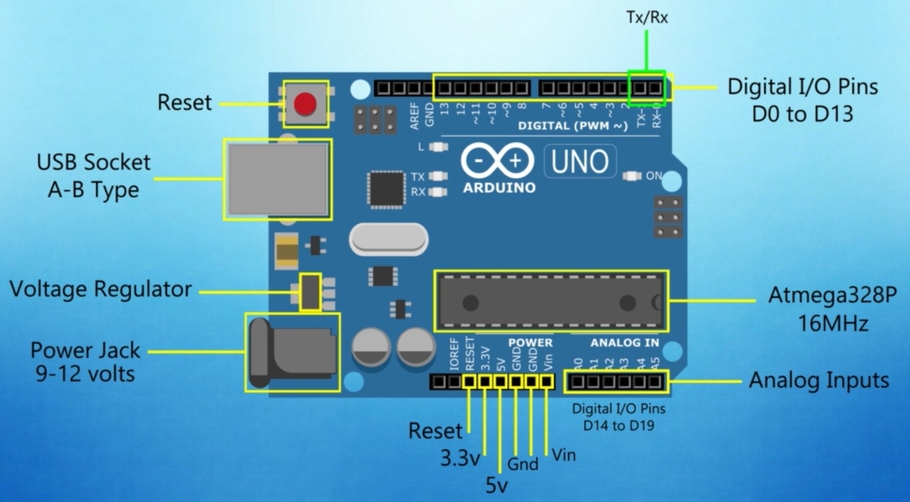
Arduino UNO and its components

Slide 4
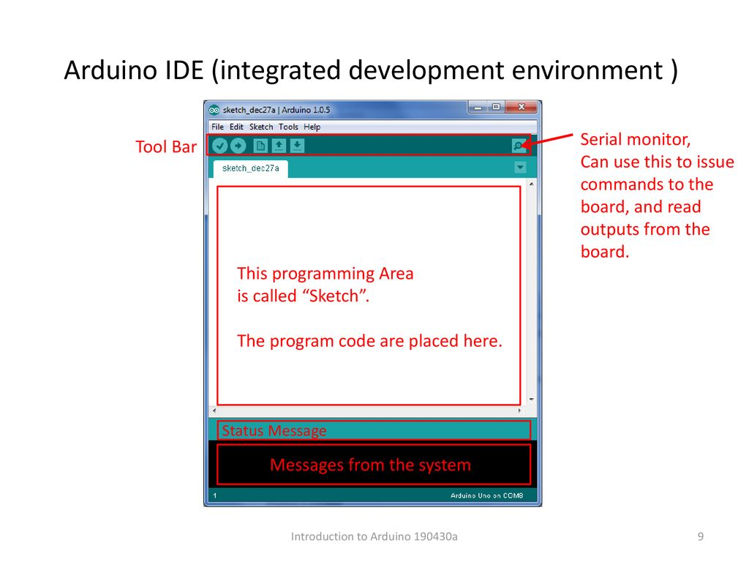
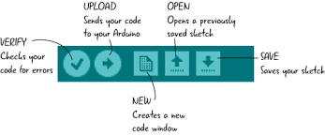

Slide 5
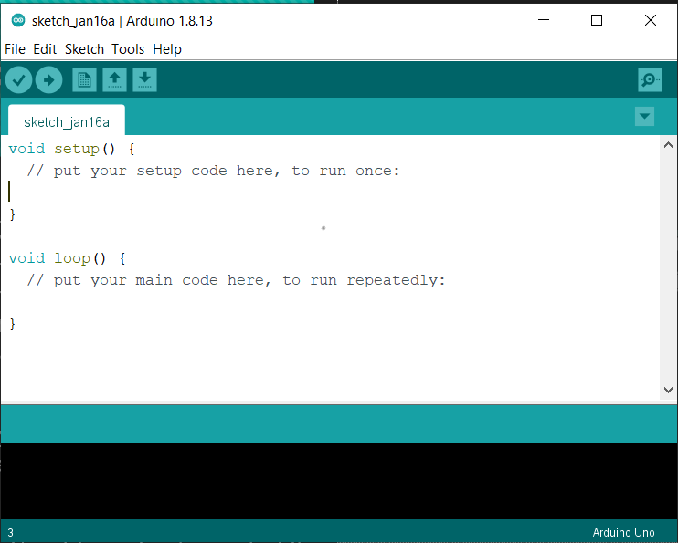
Basic Structure of Sketch
Setup Function: The setup() function is called when a sketch starts. Use it to initialize the variables, pin modes, start using libraries, etc. The setup function will only run once, after each power up or reset of the Arduino board.
Loop Function: the loop() function does precisely what its name suggests, and loops consecutively, allowing your program to change and respond. Use it to actively control the Arduino board.

Slide 6
Topics that are same in C++ and Arduino
Data Types
Operators – (conditional, relational, arithmetical)
Control Statements – (if, else, if else)
Loops – (for, while)
Functions
Arrays
Strings
Objects
Scope of variables and constants

Slide 7
Arduino I/O Functions
PinMode() : The pinMode() function is used to configure a specific pin to behave either as an input or an output.
pinMode(3,INPUT) ; // set pin 3 to input without using built in pull up resistor
pinMode(3,OUTPUT) ; // set pin 3 to output without using built in pull up resistor
digitalWrite() : The digitalWrite() function is used to write a HIGH or a LOW value to a digital pin
digitalWrite(3,HIGH); //set pin 3 to high
digitalWrite(3,LOW); //set pin 3 to low
delay() : It will pause the code for given amount of time.
delay(500); // halts the code for 500 milli seconds

Slide 8
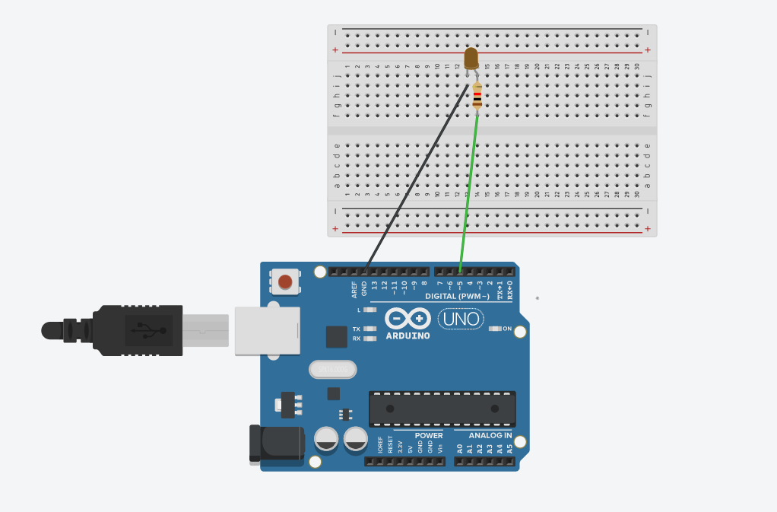
Hands – On!! Session
Try to write the code for
blinking LED
Just think like….
What to initialize in void setup
What to write in void loop to
make it
blink it continuously…
Circuit Diagram for the blinking LED

Slide 9
Serial Monitor
Serial Monitor is a special feature for Arduino which helps in communication between user and Arduino board
The serial monitor is the 'tether' between the computer and Arduino
It lets you send and receive text messages.
Handy for debugging
To work with the serial monitor, The board must be connected to the port of the laptop and the correct port and device must be selected in Arduino Ide.

Slide 10
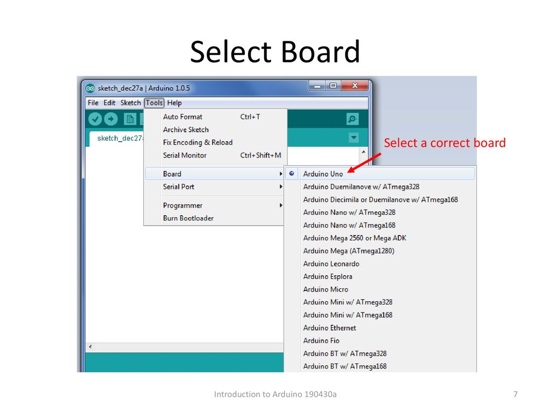
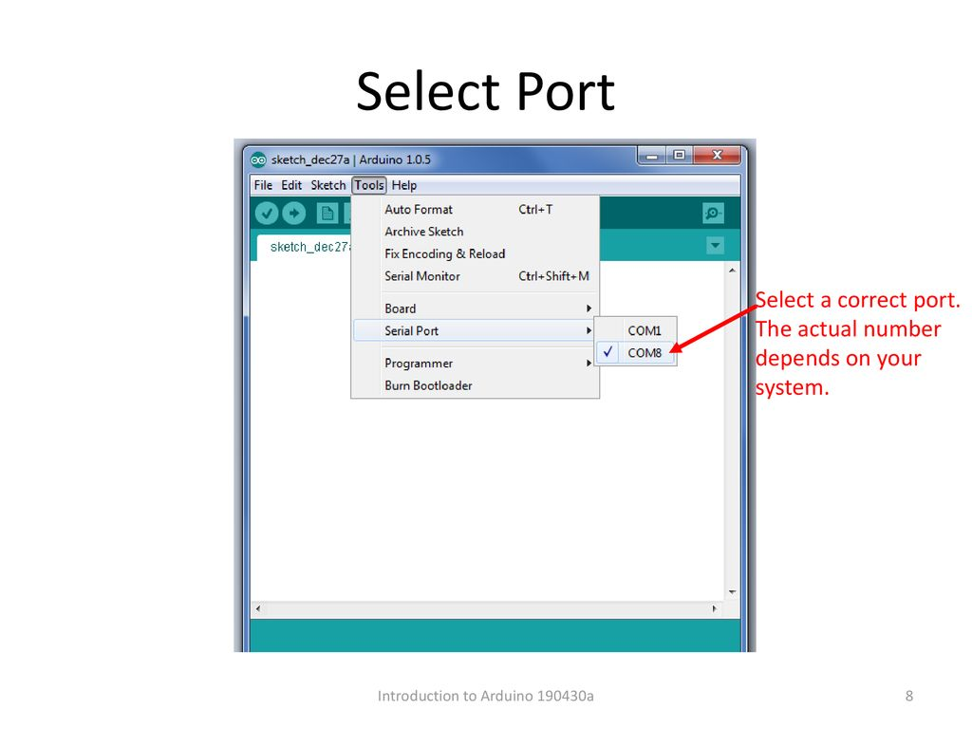
Selecting Board and Ports for Serial Communication

Slide 11
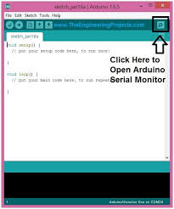
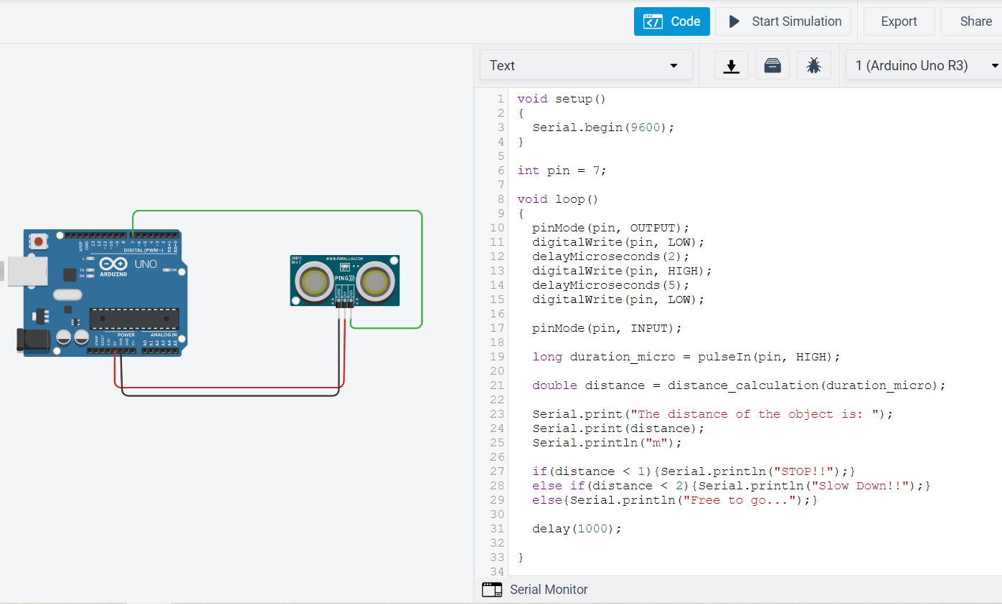
Where is the Serial Monitor
In the ‘Code’ section
In the IDE
In tinkercad

Slide 12
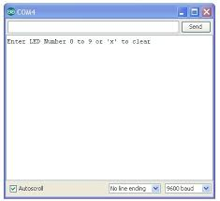
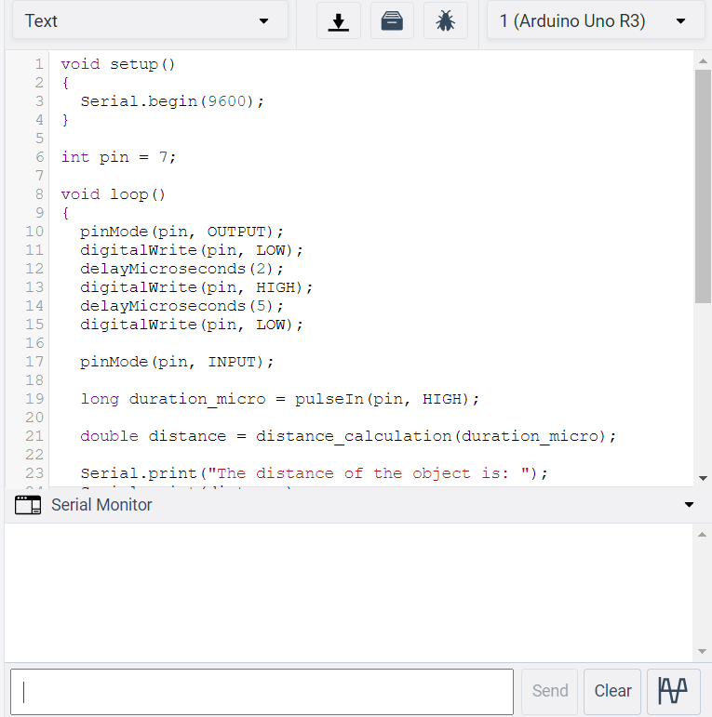
How does it look like..?
In the IDE
In tinkercad

Slide 13
Functions for using Serial Monitor
To establish Communication with Serial Monitor : -
void setup()
{
Serial.begin(9600); // 9600 is baud rate, communication rate in bps
}
To print to the Serial Monitor : -
Serial.println(value); // prints the value ‘value’ to the serial monitor
To give input to the Serial Monitor : -
if (Serial.available() > 0) { // checks if there is any data in buffer
int incomingByte = Serial.read(); // to take the input in “ASCII”
}

Slide 14
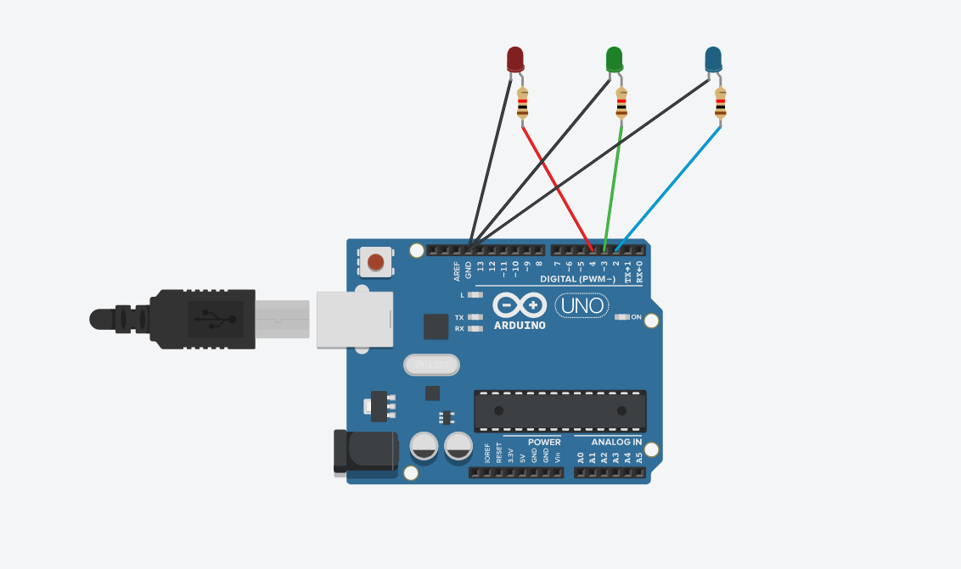
Hands On Using Serial Monitor
To give input to the Serial Monitor (2,3,4)
And blink the led’s connected to the respective pins
And print the input received to the Serial Monitor
Circuit Diagram for the Question

Slide 15
Step by Step Procedure
Step 1
First Set up the Circuit
Step 2
Establish Communication with Serial Monitor & set the pins as output.
Step 3
Write code for taking input from serial monitor and printing the corresponding LED.

Slide 16
Ultra Sonic Sensor
What do you think it is..??

Slide 17
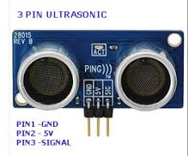
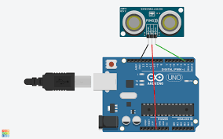
Ultrasonic Sensor
An ultrasonic sensor is an electronic device that measures the distance of a target/ obstacle

Slide 18
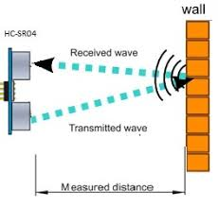
Working of Ultrasonic Sensor
The device first sends sound waves at a frequency above the audibility of human ears, which has a velocity ‘v’.
Then, the waves get reflected back from the object and then come back after time ‘t’.
So, here we have velocity of waves ‘v’ and the time taken to travel, so from that distance of the object is ‘D’, given by
D = (v*t)/2
It is multiplied by ½ since, ‘t’ is the time for going and coming back.

Slide 19
Using Ultrasonic sensor with Arduino
pulseIn() : pulseIn() waits for the pin to go from LOW to HIGH, starts timing, then waits for the pin to go LOW and stops timing. Returns the length of the pulse in microseconds
duration = pulseIn(pin, HIGH); // reads the amount of time the pulse was high

Slide 20
Hands on using Ultrasonic Sensor
Think, like an ultrasonic sensor has been attached to the front of a car
The range of the ultrasonic sensor is 3.36 m
The aim is to print a command on the Serial Monitor based on the distance of the obstacle from the car
If distance :
Is < 1m:
To stop!!
Is < 2m:
To Slow Down
Else:
Free to go

Slide 21
Flow Chart
First set up the circuit
Then, set the pin as output and send the wave
Then set the pin as input and use ‘PulseIn’ function to get the time of travel
Write the function for distance calculation
Write the code for printing to the Serial Monitor

Slide 22
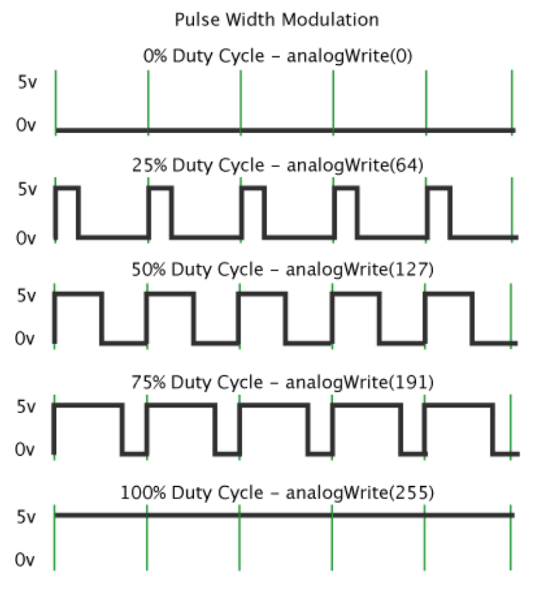
PWM (Pulse Width Modulation)
PWM – PULSE WIDTH MODULATION
PWM output is possible on
digital I/O pins 3, 5, 6, 9, 10 and 11
Technique used in controlling,
brightness of LED,
speed control of DC motor

Slide 23
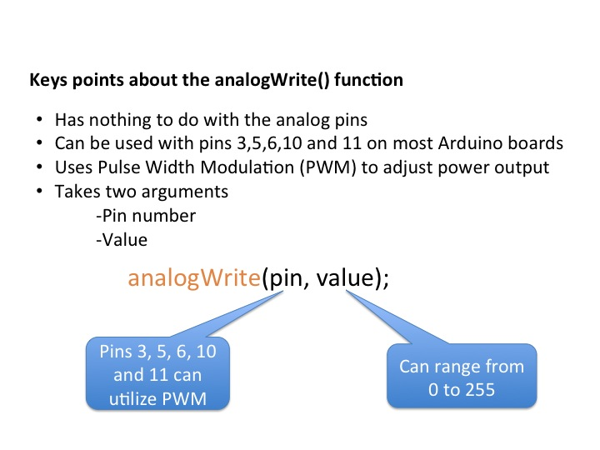
Analog Write (PWM Function)

Slide 24
Fading LED using PWM Concept
Try to write the code for
fading LED
Use a PWM pin for connecting the LED with Arduino
Use the suitable function for the fading effect
Think about the logic for fading effect

Slide 25
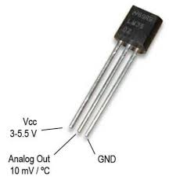
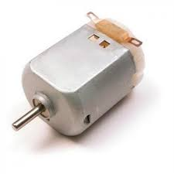
Temperature Controlled Fan
Here, We will be controlling the speed of a fan based on the temperature of the surroundings
In this circuit, We will be using a temperature sensor & a motor to replicate a fan

